Slide 1

role of media to promote democracy in Bangladesh

Slide 2
INTRODUCTON
The media is a lifeline of a nation. It provide not only information on what may affect the normal human being in his day-to-day functioning, but also by other features keeps him informed of developments, national and international.
It plays a significant role in our society in the present scenario. It is all around us, from the shows we watch on television, the music we listen to on the radio, to the books and magazines we read each day. Television, more than any of the other media, achieves myriad different goals.
“If it were left on me to decide whether we should have a government without newspapers or newspapers without a government, I should not hesitate a moment to prefer the latter.”-Thomas Jefferson

Slide 3
MEDIA AND DEMOCRACY
A democracy is a government of the people, for the people and by the people where people elects their representatives.
Thus, the public opinion is an important aspect. The people in turn could hold the government accountable and change it, if they knew what was doing.
So, there is a need to inform the people of things around them so that there is a check on the government. And media is the one who informs them.

Slide 4
Media plays a crucial role in shaping a healthy democracy. It is the backbone of a democracy and acts as an interface between the common man and the Government.
It makes us aware of various social, political and economical activities happening around the world. It is like a mirror, which shows us or strives to show us the bare truth and harsh realities of life.
The media is a vital source of important information for people, primarily in the form of news that may affect them. People can be forewarned of problems and issues, so they can make better choices about their future.

Slide 5
ROLE OF MEDIA
As an Informer
It supplies the information in true and unbiased form and let the public choose, what may be the best in their interest.
It is the media only who reminds politicians about their unfulfilled promises at the time of elections.
The excessive coverage T.V news channels during elections helps people, especially illiterates, in electing the right person to the power.
This reminder compels politicians to be perform their promises in order to remain in power.

Slide 6
Creation of Public Opinion
In an uneducated democracy, public opinion has to be generated and some agency is required to do work. An instrument of mass communication can serve the requirement of effective mobilization of national opinion. This is the only way a democracy can survive.
Television and radio have made a significant achievement in educating rural illiterate masses in making them aware of all the events in their language.
The media also exposes loopholes in the democratic system, which ultimately helps government in filling the vacuums of loopholes and making a system more accountable, responsive and citizen-friendly. A democracy without media is like a vehicle without wheels.

Slide 7
Forms of Democracy
There are two types of democracy
Direct Democracy: - When the people themselves directly express their will on public affairs, the type of government is called pure or direct democracy. Direct Democracy was established in ancient Greek city-states. This system now prevails only four cantons of Switzerland.
Representative or Indirect Democracy: Indirect Democracy the will of the state is formulated and expressed not directly by the people themselves, but by their representatives to whom they delegate the power deliberation and decision-making. This type of government was established in England in the seventeenth century. In France, it was established in 1830 and in Italy in 1948. Today this system is seen in many countries like- Bangladesh ,Japan, Sri Lanka, India, Canada, Australia, New Zealand, the United States of America, West Germany, Italy, France, Holland, Denmark, Sweden, Norway, Austria and Belgium.

Slide 8
Basic Principles of Democracy
Liberty
Equality
Fraternity
The people as ultimate source of sovereignty
Fundamental rights to the people
Independence of Judiciary
The people are considered as an end and State as the means in a democracy
Welfare State

Slide 9
Present features of Bangladesh Democracy
Absence of democratic political culture.
Absence the rule of law.
Absence of strong civil society.
Absence of strong political leadership.
Corruption and terrorism.
Lack of political morality.
Problems of Parliamentary Committee System.
Problems of Public Administration
Problems of Political Parties.
Problems of Press and Media.
Problems of Local Government.
The Leadership Problem.

Slide 10
Prospects of democracy in Bangladesh
The people of our country are almost homogeneous.
Provision for caretaker government.
People's eagerness for democracy.
Peaceful transition of power.
Response of civil society.
Independence of press, media and newspaper.
Privatization.
Role of NGO.
Women Empowerment.
March to ward too party system.

Slide 11
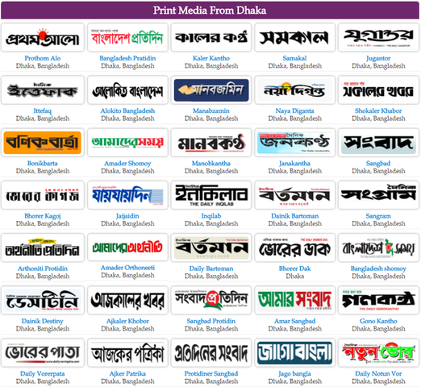
Print media from Bangladesh

Slide 12

Bangladeshi tv channels

Slide 13

Bangladeshi radio channels

Slide 14
Overview
The media in Bangladesh is a mix of government owned and private media. There are still criminal penalties for libel, defamation and sedition as well as reporting on national security issues. Reporters can be held for up to 120 days without trial under the 1974 Special Powers Act. Media restrictions have usually increased during periods of political turmoil. Reporters Without Borders has accused the army of targeting journalists and enforcing censorship.

Slide 15
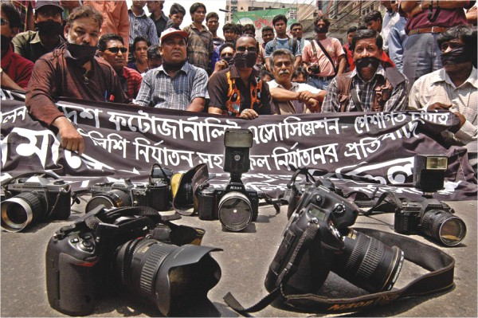
Democracy and Media Freedom
For a democratic government it is essential to maintain a media, which is free from censorship since media freedom signifies the right of free speech and is crucial for promoting respect for differences of opinions, a key aspect of a democratic society. However, in Bangladesh, despite the media playing a positive role in upholding the democratic values in many aspects, freedom of media is still heavily constrained.

Slide 16
Example
Example even after the landslide win of Bangladesh Awami League which has formed the present government with overwhelming support given by the people of Bangladesh after the last election, we have seen unfortunate clamp down on web-based media promoting citizen journalism and voices of ordinary people. Therefore, temporary closure of YouTube and Facebook in addition to closing of private satellite channel Channel 1 and temporary shut down of Daily Amar Desh reinforces the fact that media in Bangladesh is still far from being free which brings us near to the point that democracy in Bangladesh still has many challenges to overcome where the challenge of media freedom is not a stand-alone factor. It should be kept in mind that crackdown on media has been a normative practice by governments since its inception as a country. The degree and dimension of crackdown, however, varies from regime to regime.
In order to understand underlying factors hindering the growth of media freedom in Bangladesh this article examines the concept of freedom of media and its significance in a democratic society before examining Bangladesh's stance globally in relation to free media.

Slide 17
Tension between media and government
There has always been tension between the media and government of Bangladesh. Whenever a news report criticizes government, we see government bashing the media, advising it to be more 'objective' and report on 'factual basis'. On the other hand, according to IPI, 'Journalists, in the meantime, felt that politicians fail to understand that holding government to account is one of the fundamental roles of journalism. This means that many politicians fail to appreciate the importance of investigative and independent journalism.'
The IPI report stresses that: ‘The government is perceived as abusing its power to allocate advertisements by refusing to advertise in newspapers perceived as critical of its policies. This deprives newspapers of an important source of revenue, exercising undue pressure on editorial independence.'

Slide 18
Corporate ownership and interest
At present one of the emerging tends in media ownership is that big conglomerates own newspaper and private satellite channels. Theoretically and in practice therefore news media are influenced. As a result, in the recent past we saw 'media war' among major national dailies and television channels. Furthermore, since unfortunately advertisements are still a major source of revenue generation, as per a telephone survey conducted by this writer among various business reporters, it has emerged that some news against big multinational companies which provide handsome number of advertisements to print and electronic media died before publication.

Slide 19
conclusion
Despite so many constraints, Bangladeshi news media played a brave and praiseworthy role in upholding democratic values in the country whether it was during the time of illegal army regimes or autocratic democratic regime. Therefore, a patriotic government and media owners must realize the potential of media freedom for a democratic society and take necessary measures to lessen legal, political and business controls over media.

Slide 20
THANK YOU

